Slide 1

Overview statistical software
Sili Fan WCMC statistician

Slide 2





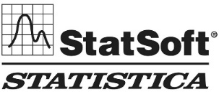









How to do statistics ?
Scripting
Clicking or GUI
(Flexible)
(Fixed)
Local installation
Local installation
Online
Online
Microsoft
MetaboAnalyst (R-based)
Met-DA (R-based)

Slide 3
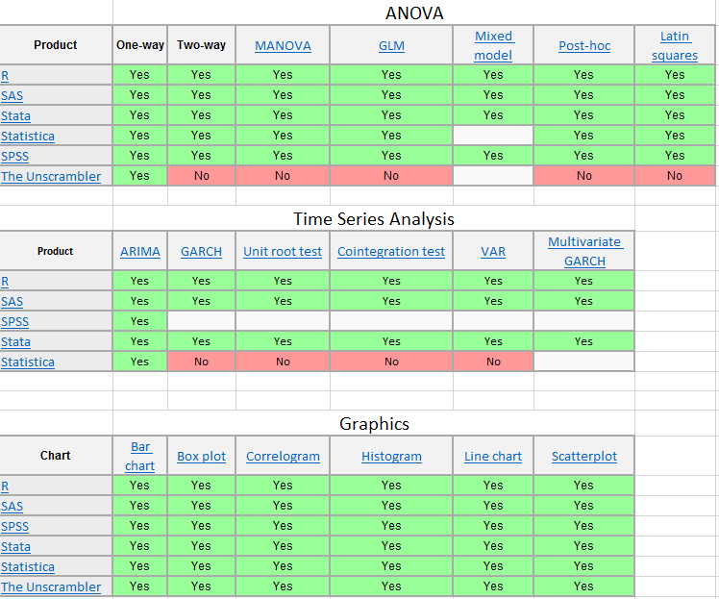
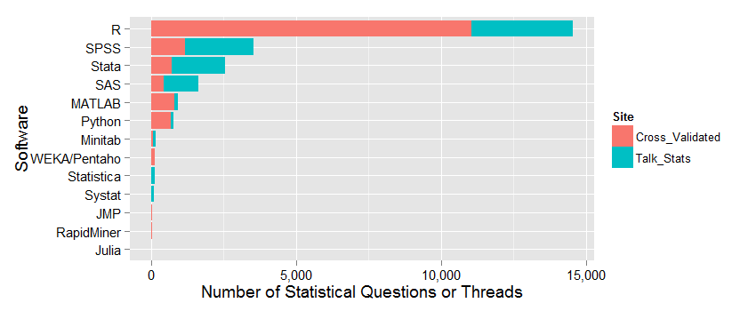
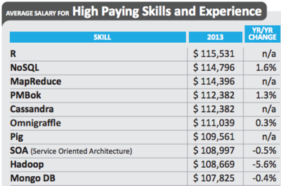

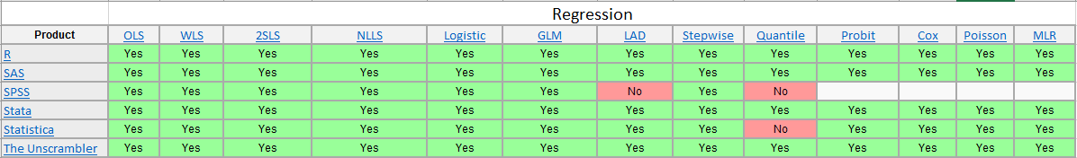
Which software to use?
And
the winner is
https://en.wikipedia.org/wiki/Comparison_of_statistical_packages

Slide 4
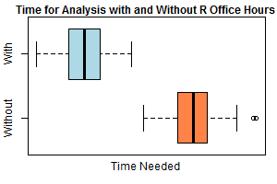
The Pros and Cons of R
Pros
Cons
Powerful, state-of-the-art
Used by professional statisticians
Lots of documentation
Learn by example
Free
Programmable
Produces publication quality graphics
Build your own package
Not very easy to learn

Slide 5
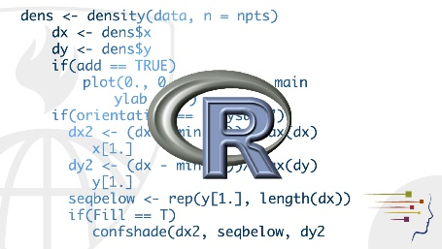
To master R
Installation
Know exactly what you want to do
Ask Google

Slide 6


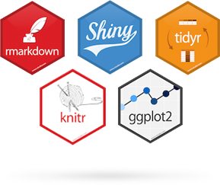
To master R
- installation
1 Install R
2 Install RStudio
https://cran.r-project.org/bin/windows/base/
https://download1.rstudio.org/RStudio-1.1.456.exe
R is in the PC main box
RStudio is the user-interface of R
3 Packages can be added later

Slide 7
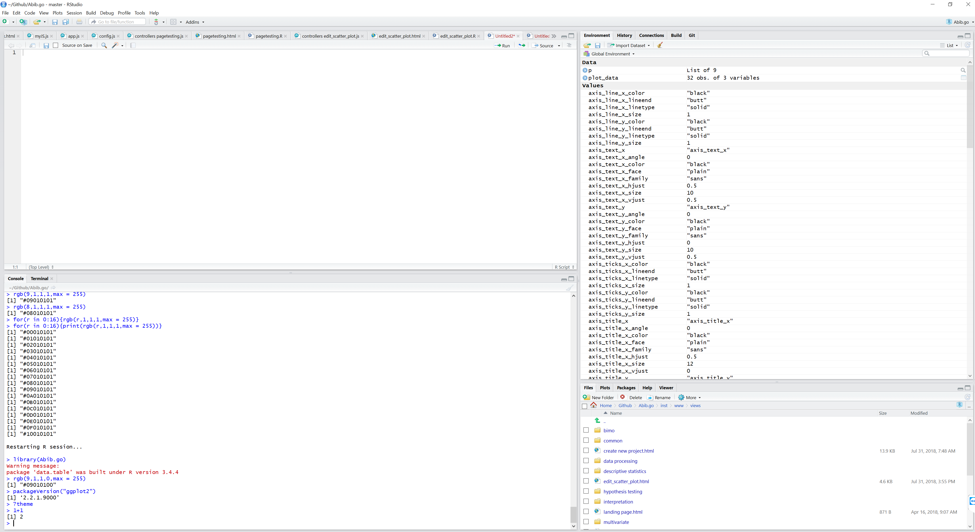
To master R
- installation
Where you build your constant code
Where you build your instant code

Slide 8
To master R
- Know exactly what you want to do
How to perform t-test?
How to read csv into R
How to perform t-test on each column of my data in R
How to extract p value from t-test result in R
How to save table as csv in R

Slide 9


To master R
- Ask Google
There is a whole community of R users so all the question you’ll face are already faced (and probably solved) by others.
A popular forum for R questions is
A popular forum for statistics questions is
Recommended R source:
http://r-statistics.co/Top50-Ggplot2-Visualizations-MasterList-R-Code.html
https://www.intechopen.com/books/metabolomics-fundamentals-and-applications/processing-and-visualization-of-metabolomics-data-using-r
https://www.kaggle.com/kernels
https://github.com/daattali/addinslist

Slide 10
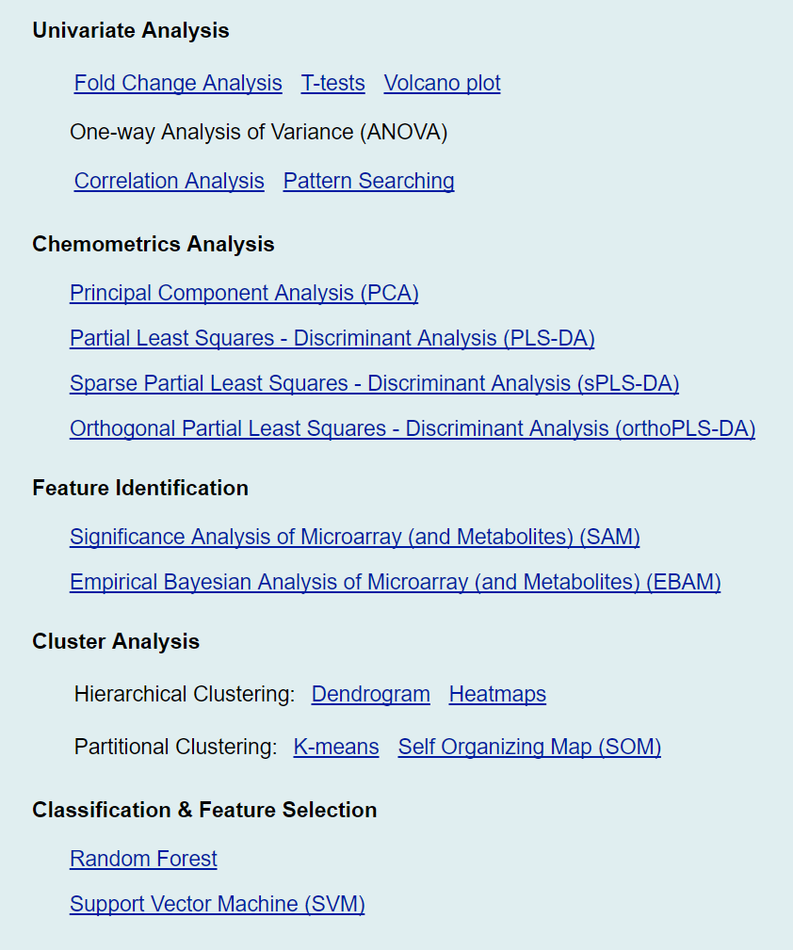
MetaboAnalyst
http://www.metaboanalyst.ca/
Pros
Easy to navigate
Provides commonly used statistical methods
Cons
Missing linear and logistic regression methods
Missing survival models
Missing batch effect removal
No access to R-scripts used
Not good for complex studies

Slide 11
MetDA
http://metda.fiehnlab.ucdavis.edu/
Study design
Power analysis
Data processing
Missing value computation
Outlier detection
Normalization & batch effect removal
Transformation
Scaling
Descriptive statistics
Hypothesis testing
Student t-test
Mann-whitney test
Wilcoxon-signed-rank test
Kruskal walis test
One-way ANOVA
Two-way ANOVA
Two-way mixed ANOVA
Two-way repeated measured ANOVA
Normality test
Association modeling
Linear regression
Logistic regression
Survival models
Multivariate analysis
Principal component analysis
Hierarchical cluster analysis
PLS-DA
Classification prediction
Random forest
Support vector machine
LightGBM
Will be Used in the course

